Slide 1
Chapter 2 Practice Test
Consumer Math
Mastery Test A

Slide 2
465¢
72¢
12¢
$0.53
$1.95
$0.03

Slide 3
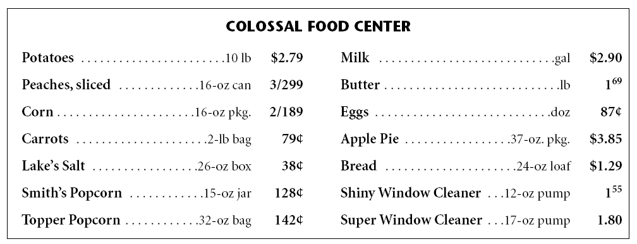
7. How much is one package of corn?
$1.89 ÷ 2 = 0.945, round, $0.95
8. Mrs. Valle buys 10 pounds of potatoes, two apple pies, and one can of peaches. How much is her total bill?
$2.79 + $3.85 + $3.85 + $1.00 = $11.49
9. If Mrs. Valle gives the salesclerk $20, how much is her change?
$20.00 - $11.49 = $8.51

Slide 4
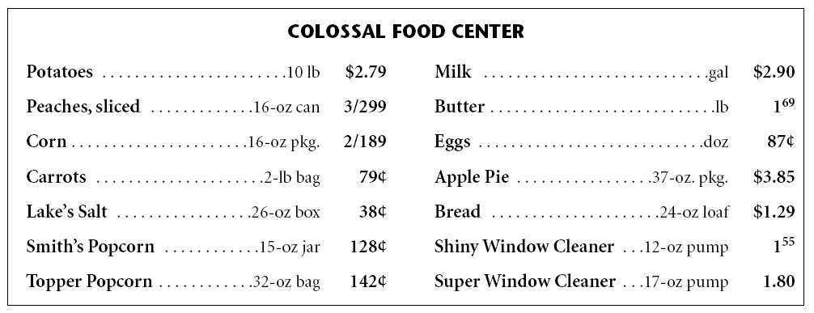
10. Find the unit price of Smith’s Popcorn. How much does it cost per ounce?
$1.28 ÷ 15 = 0.0853333, round, 9¢
11. Find the unit price of Topper Popcorn. How much does it cost per ounce?
$1.42 ÷ 32 = 0.044375, round, 4¢
12. Oscar uses a 20¢ off coupon when he buys Super Window Cleaner. How much does this window cleaner cost per ounce?
$1.80 - $0.20 = $1.60, $1.60 ÷ 17 = 0.0941176, round, 9¢

Slide 5
13. Tanya and Nerissa eat dinner at a restaurant. The bill totals $23.41. They want to leave a 15% tip. How much should each person pay?
$23.41 x .15 = $3.5115
Round to $3.51
$23.41 + $3.51 = $26.92
$26.92 ÷ 2 = $13.46

Slide 6
D; 3¢
A; 7¢

Slide 7
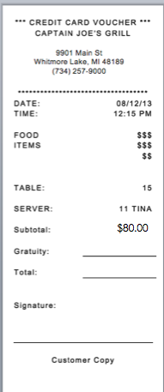
16.
If 3 people are splitting the bill, how much should each person pay?

