Slide 1
Lesson 2: Amount Saved
Consumer Math
p. 60

Slide 2
Example:
Merchants often sell items at reduced prices. A careful shopper watches for these sales because they could provide good bargains.
ITEM | REGULAR PRICE | SALE PRICE | AMOUNT SAVED
DRESS | $70.00 | $57.99
SOCKS | $4.29 | $3.19
($70.00 - $57.99)
$12.01
($4.29 - $3.19)
$1.10

Slide 3
Lesson 3: Percent Saved
Consumer Math
p. 61

Slide 4
To find the percent of the regular price saved on a sale item, divide the amount saved by the regular price. Then change the decimal to a percent.
Example:
Regular price: $39.99
Sale price: $17.00
$39.99 - $17.00 = $22.99 (amount saved)
$22.99 / $39.99 = 0.5748937 (round)
Answer: 57%

Slide 5
Lesson 4: Discounts
Consumer Math
p. 62

Slide 6
A discount indicates an amount subtracted from the regular price. Stores may give discounts to reduce prices for a sale. Occasionally a store offers a percent off every item in the store. Sometimes this discount is given at the checkout counter and is not marked on the price tag. Before you decide to buy an item, you will need to compute the sale price to decide if it is a good bargain.

Slide 7
Example
ITEM | REGULAR PRICE | DISCOUNT | SALE PRICE (regular price x difference of discount) | AMOUNT SAVED (regular price – sale price)
JEANS | $23.30 | 36%
SHIRT | $17.43 | 12%
COAT | $46.90 | 24%
($23.30 x .64)
$14.91
($23.30
- $14.91)
$8.39
($17.43
- $15.34)
$2.09
($17.43 x .88)
$15.34
($46.90
- $35.64)
$11.26
($46.90 x .76)
$35.64

Slide 8
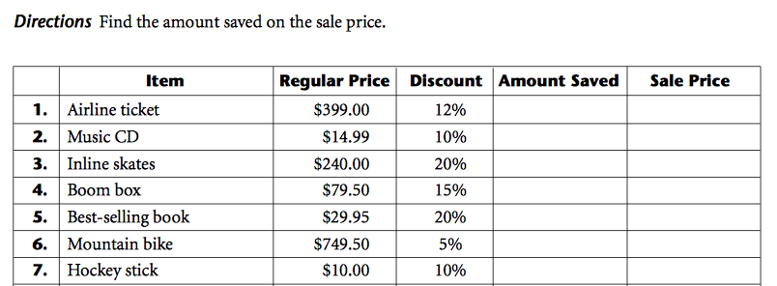
Worksheet

