Slide 1
Lesson 6: The Key to Simplifying Fractions
Consumer Math
p. 66

Slide 2
A fraction is made up of a numerator and a denominator. To simplify fractions, divide the numerator and the denominator by the greatest common factor.

Slide 3
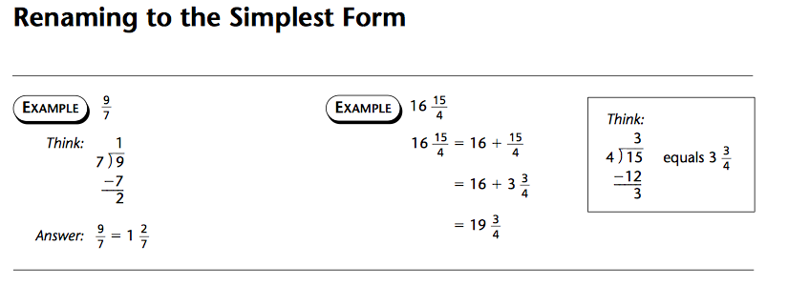
Example

Slide 4
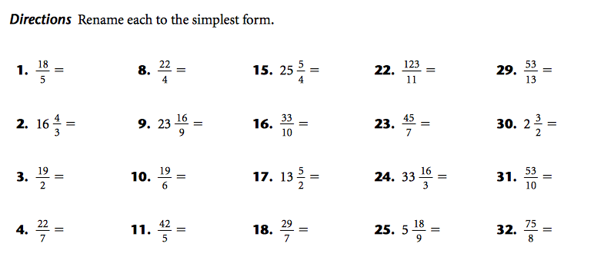
Worksheet

Slide 5
Lesson 7: The Key to Common Denominators
Consumer Math
p. 67

Slide 6
The number being multiplied is called a factor. To change the denominator of a fraction, multiply the numerator and the denominator by the same factor.

Slide 7
Worksheet

Slide 8
Example

Slide 9
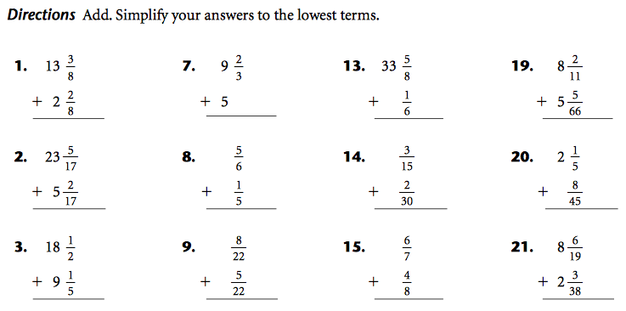
Worksheet

Slide 10
Example

Slide 11
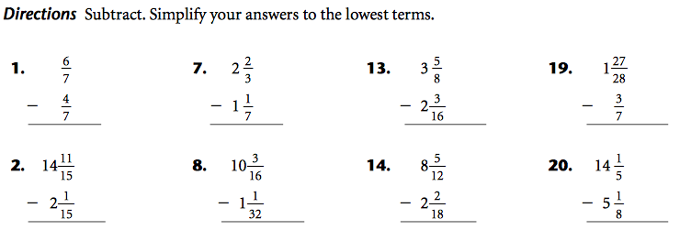
Worksheet

Slide 12
Example

Slide 13
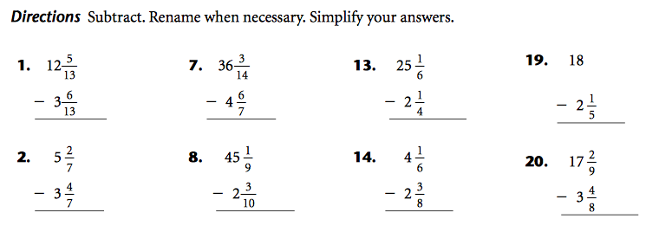
Worksheet

Slide 14
Example

Slide 15
Worksheet

