Slide 1
Applications of Geometric Series

Slide 2
A company is offering a job with a salary of $30,000 for the first year and a 5% raise each year after that. If that 5% raise continues every year, find the amount of money you would earn in a 40-year career.

Slide 3
Deanna received an e-mail asking her to forward it to 10 other people. Assume that no one breaks the chain and that there are no duplicate recipients.
How many e-mails will have been sent during the 8 generation only, Diana’s being the first?

Slide 4
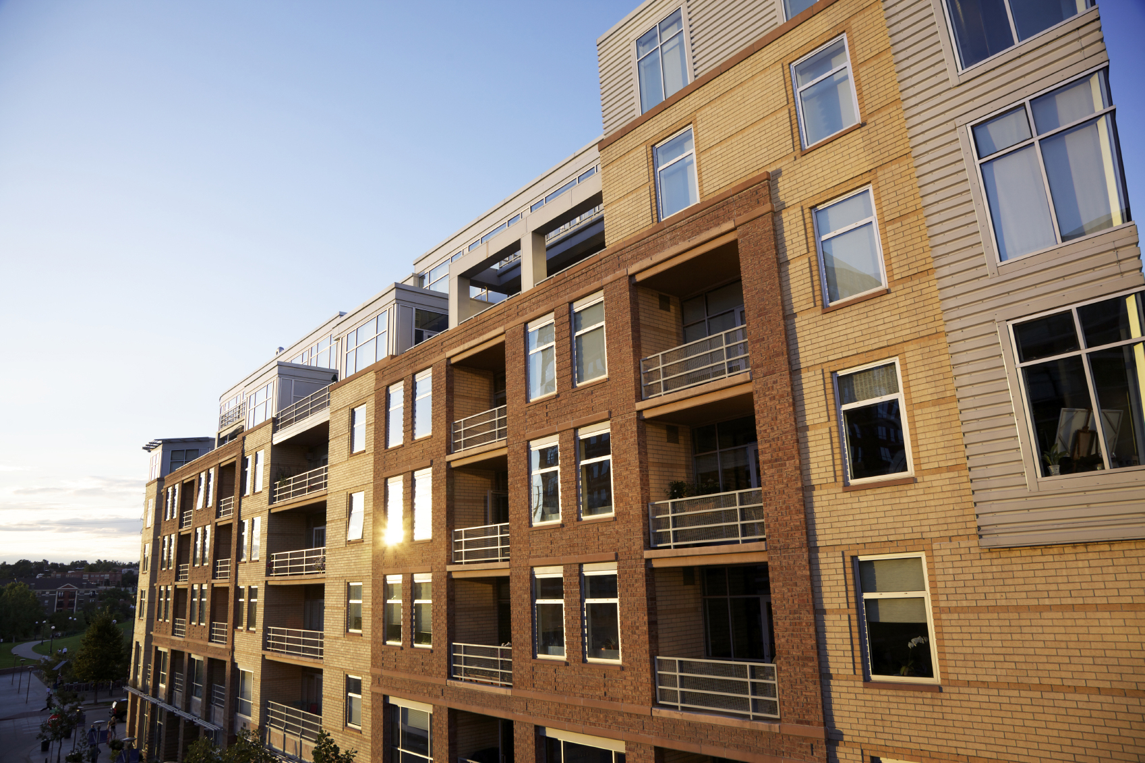
Miguel paid $9600 rent for his apartment the first year. Every year for the next 3 years the rent increased 5%. How much rent did he pay in the fourth year?

Slide 5
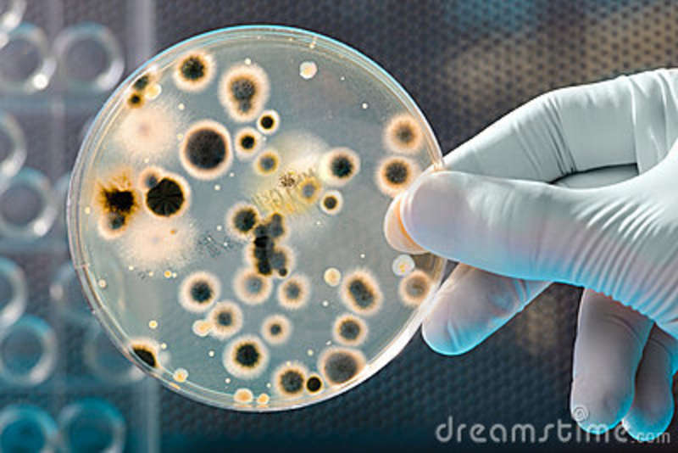
A culture of bacteria doubles every hour. If there are 500 bacteria at the end of the first hour, how many bacteria will there be after 12 hours?

Slide 6
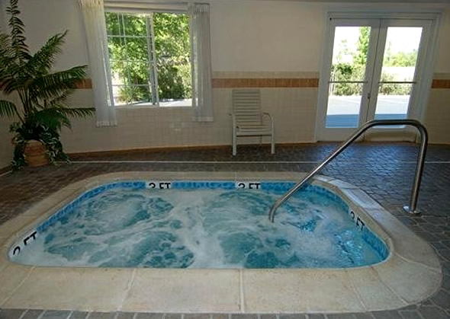
You complain that the hot tub in your hotel suite is not hot enough. The hotel tells you that they will increase the temperature by 10% each hour. If the current temperature of the hot tub is 75º F, what will be the temperature of the hot tub after 3 hours, to the nearest tenth of a degree?

