Slide 1
What if Angry Birds Didn’t Grade With SBG?
Understanding Standards Base Grading vs Traditional Grading

Slide 2
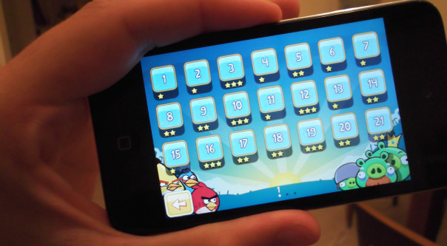
Angry Birds with SBG
Notes:
Right? Levels graded separately that you can play over and over until you gain mastery? I’m sure others have thought of this analogy, but it seems pretty solid to me. So now contrast this to what the Angry Birds score screen would look like if it “graded” in the traditional manner:

Slide 3
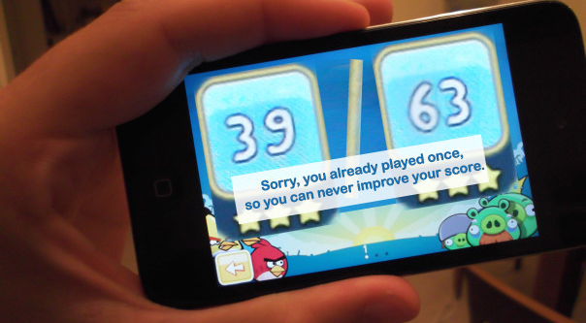
Angry Birds Graded in Traditional Manner
Notes:
This would suck because I never get 3 stars the first time around.

Slide 4
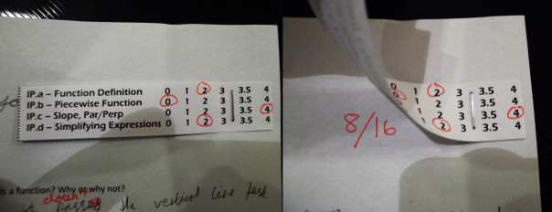
SBG vs Traditional Grading

Slide 5
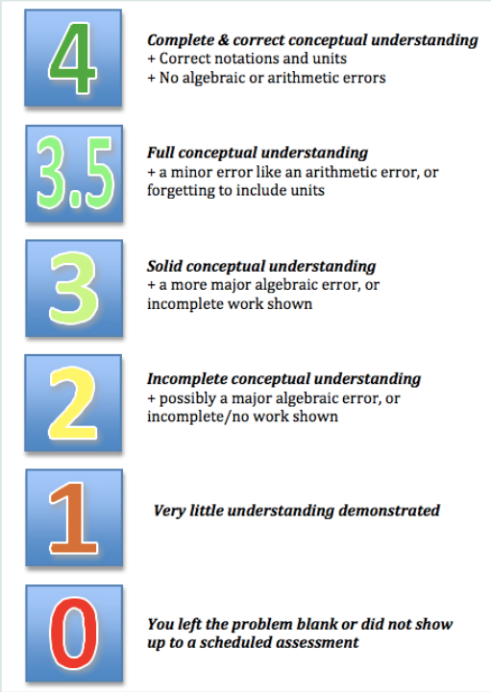
How Standards Assessments will be Graded

Slide 6
Metacognition
(Thinking about how you think)
Those that believe they can always grow and always get smarter will end up growing far more easily than those that believe that intelligence is fixed.
Notes:
Don’t compare yourself to others compare yourself to yourself

