Slide 1
Unit 3: Section 3
Represent Functions as Rules and Tables

Slide 2
Functions
When you pump gas, the total cost depends on the number of gallons pumped. The total cost is a function of the number of gallons pumped.
A function consists of:
A set called the domain containing numbers called inputs, and a set called the range containing numbers called outputs.
A pairing of inputs with outputs such that each input is paired with exactly one output.

Slide 3
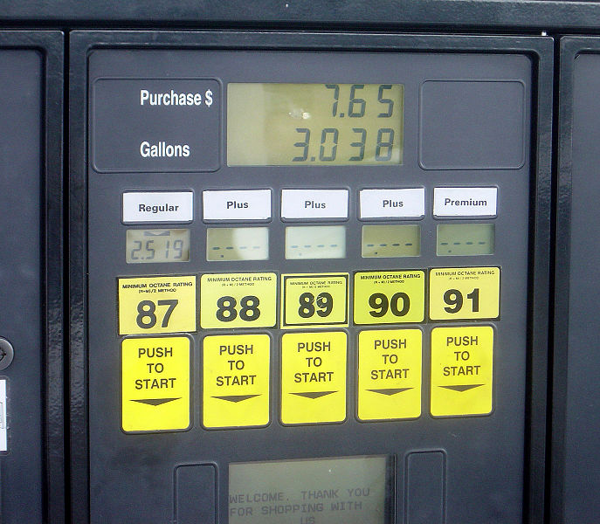
Example 1: Identify the domain and range of a function.
The input-output table shows the cost of various amounts of regular unleaded gas from the same pump. Identify the domain and range of a function.
Input (gallons) | 10 | 12 | 13 | 17
Output (dollars) | 19.99 | 23.99 | 25.99 | 33.98

Slide 4
Example 1:
Make a table for the function . Identify the range of the function with a domain of 10, 12, 15, 20, and 21.

Slide 5
Example 2:
Make a table for the function . Identify the range of the function with a domain of 0, 2, 3, 5, and 10.

Slide 6
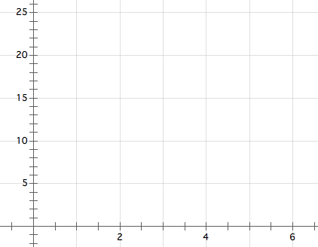
Example 3:
Graph a function with a domain of 1, 2, 3, 4, and 5.

Slide 7
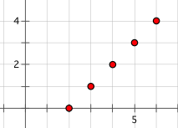
Example 4:
Write a rule for the function represented by the graph. Identify the domain and range of the function.

Slide 8
Example 5:
The function has a domain of 2, 3, 5, 7, and 8. Which number is not in the range of the function?
(A) 8 (B) 12
(C) 18 (D) 20

Slide 9
Example 6:
The Ruizes offer each of their children two different options for increasing the child’s weekly allowance.
Option 1: Increase the allowance by one half of the current allowance.
Option 2: Increase the allowance by $3 per week.
Describe under what conditions each option is preferable. Justify your answers.

Slide 10
Example 7:
What is a rule for the function given by the input-output table?
(A) (B)
(C) (D)

Slide 11
Example 8:
The number of adult tickets sold at a school talent show is 5 less than 3 times the number c of children’s tickets sold. Which expression represents the number of adult tickets sold?
(B)
(C) (D)

Slide 12
Example 9:
The table represents a function that can also be represented by a rule. What is the missing value in the table?

Slide 13
Example 10:
Write a rule for the function given by the input-output table?

Slide 14
Example 11:
Write a rule for the function given by the input-output table?

